Slide 1
ABAP Part I
Lesson 03: DDIC - I

Slide 2
Lesson Objectives
After completing this lesson, participants will be able to -
Use Data Dictionary to maintain Database Objects
Work with
Domain
Data Elements
Tables
Structures

Slide 3
Data Dictionary
Data Definitions are created and Managed in ABAP Dictionary
Describes the logical structure of objects use in application development
Describes the mapping of data to the underlying Relational Database in tables and views
System Independent interface to the Database
Virtual Database
Provides data for manipulation and processing
Transaction Code : SE11

Slide 4
ABAP Dictionary
Object Types in ABAP Dictionary are
Tables
Defined in Dictionary
Independent of Database
Views
Logical Views
Types
Data elements
Structures
Domain
Defines a Value Range

Slide 5
ABAP Dictionary
TABLES
Has one or More fields
Contains data in the form of Rows and Columns
DATA ELEMENTS
Field of a table refers to Data Element
Specifies Non-Technical Attributes
DOMAIN
Specifies Technical Attributes
Attached to Data Element

Slide 6
Standard Tables
Table | Description
DD02L | List of All Tables
TSTC | List of All Tcodes
TADIR | R/3 Repository Objects
T000 | Clients

Slide 7

Types of Table
Table Types
Transparent Tables
Pooled Tables
Cluster Tables

Slide 8
Tables
Transparent Tables
One-to-one relationship with tables in database
Most commonly Used
Holds Application data
Master data or Transaction data Used by an application
Master Data : Vendor Table
Transaction data : Orders Placed By Customers

Slide 9
Tables
TABLE FIELDS
Field Name
Should begin with an Alphabet
Key Flag
Determines the Primary Key
Field Type
Data Type
Field Length
Decimal Places
Number of Decimal Places
Short Text – Description of the field

Slide 10
Tables - Transparent
Creation of Tables
Top-Down Approach
Table is first created
Data element and Domain are created after creation of Table
Easier to Use
Bottom-Up Approach
Domain and Data element are created
More intuitive for first timers
Cumbersome

Slide 11
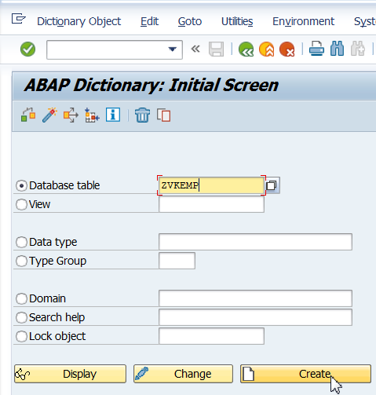
Table Creation
Specify the Table Name

Slide 12
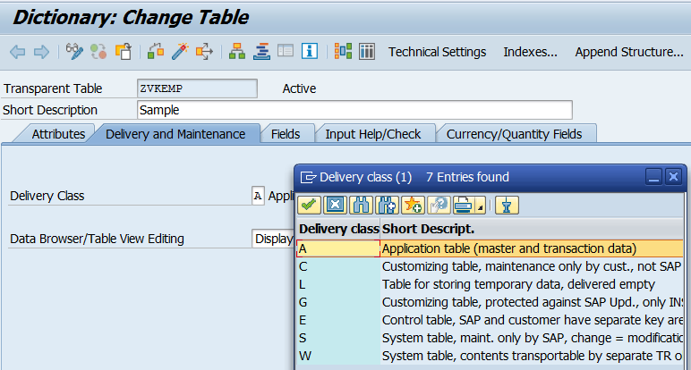
Table Creation
Choose Delivery Class

Slide 13
Delivery Classes
The delivery class controls the transport of table data for installation, upgrade, client copy and when transporting between customer systems.
There are the following development classes:
A: Application table (master and transaction data)
C: Customer table, data is only maintained by the customer.
L: Table for storing temporary data
G: Customer table, SAP may insert new data records but may not overwrite or delete existing ones
E: System table with its own namespace for customer entries. The customer namespace must be defined in table TRESC
S: System table, data changes have the status of program changes.
W: System table (e.g. table of the development environment) whose data is transported with its own transport objects (e.g. R3TR PROG, R3TR TABL, etc.).

Slide 14
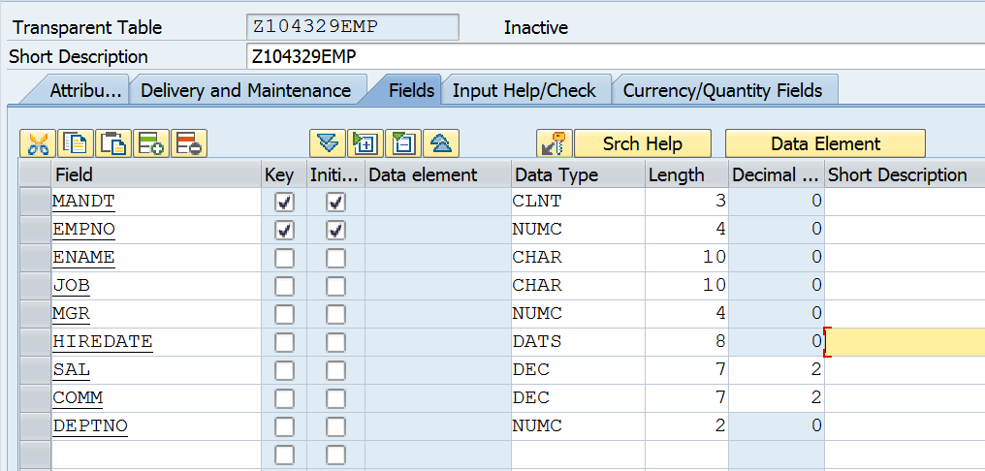
Table Creation - Fields

Slide 15
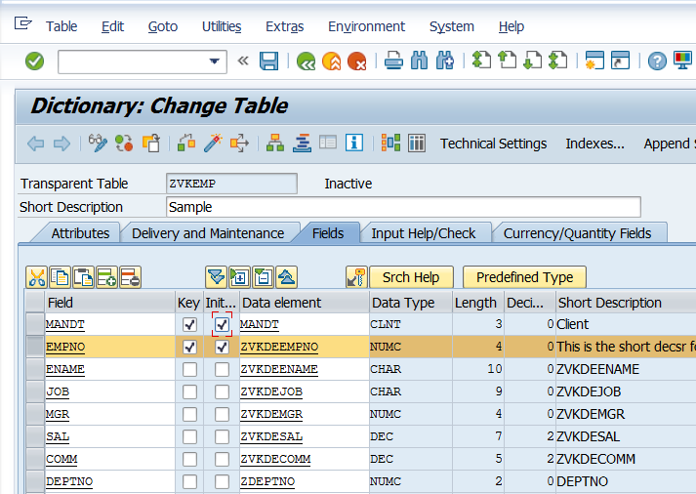
Table Creation - Fields
Primary Key Field
Specify the field names
Data Element

Slide 16
Demo
Create a custom Table

Slide 17
Table Creation
CONSTRAINTS
Key Fields must be stored at the beginning of the field list
Non-Key fields may not occur between two key fields
Maximum of 16 key fields per table is allowed
Table may not have more than 249 fields

Slide 18
Tables
Client Dependent Table
First Field has Data Type CLNT
Part of PRIMARY KEY Field
Client Independent Table
A table whose First field is not of Data Type CLNT

Slide 19
Demo
SE11 interface and create a simple table based on pre defined datatypes.

Slide 20
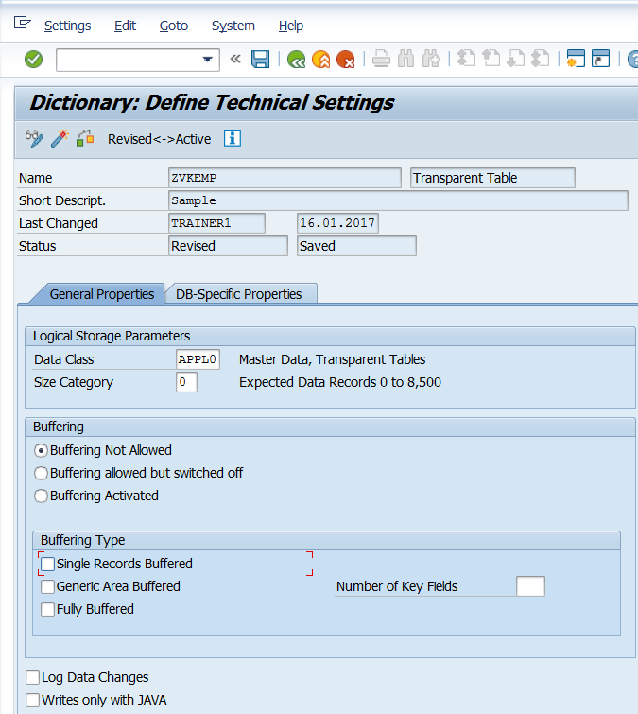
Tables – Technical Settings

Slide 21
Data Class
The data class logically defines the physical area of the database where your base database table resided.
Hence, you should choose the data class correctly, the table will automatically created in the appropriate area on the database when it is activated in the dictionary.
The most important data classes are master data, transaction data, organizational data and system data
The data class determines the table space that the table is assigned to.
A tablespace is a physical file on the disk which is used to hold tables
Every table is assigned to one tablespace

Slide 22
Data Class
If you choose the data class correctly, your table is automatically assigned to the correct area (tablespace or DBspace ) of the database when it is created.
Each data class corresponds to a physical area in which all the tables assigned to this data class are stored.
There are the following data classes:
APPL0 (Master Data): Data which is seldom changed. An example of master data is the data contained in an address file, such as the name, address and telephone number.
APPL1 (transaction data): Data that is frequently changed. An example of transaction data is the goods in a warehouse, which change after each purchase order.
APPL2 (organizational data): Customizing data that is defined when the system is installed and seldom changed. An example is the table with country codes.

Slide 23
Data elements , Domain and fields
Field
Is composed of
Data Element
Contains field labels and online documentation
Needs a
Domain
Describes technical characteristics. E.g data type and length
Customer table
fields
Data Elements
Domain
Phonew
Phonef
phoneh
Zphonew
Label: work number
Zphone
Type:char
Len:12
Zphonef
Label: fax
Zphoneh
Label: home phone

Slide 24
Domain
Specifies the Technical Characteristics of a Field
Data Type
Length
Defines a Value Range
Can be restricted by defining Fixed Values
Define Value Table to check against a Table
Assigned to a Data Element Defines Value Range

Slide 25
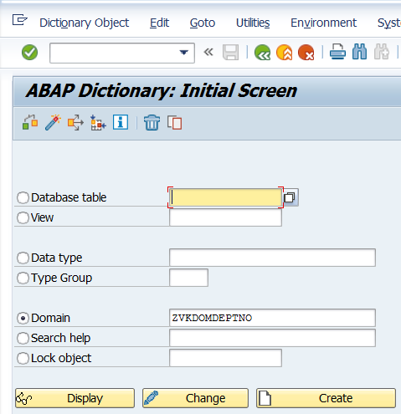
Creating Domain
Tcode : SE11
Choose Domain
Specify the Domain Name starting with Y or Z

Slide 26
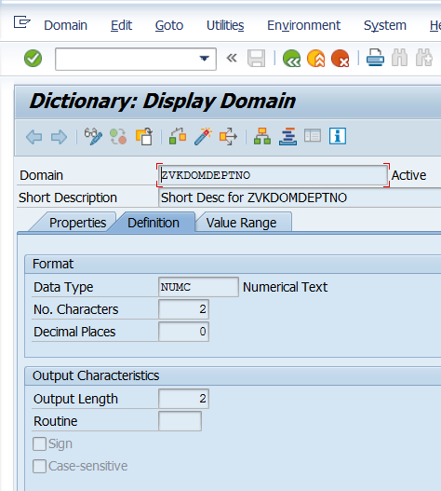
Creating Domain
Specify the Datatype
Length for the Datatype

Slide 27
Creating Domain (Contd.).
Save the Domain
Specify the Package
Activate
Domain is ready and can be attached to a Data Element

Slide 28
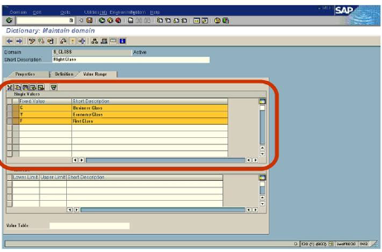
Domain
Value Range and Fixed Values
Used to restrict the values in the Domain
Used in input check in screen templates
If no other help is defined in field, Value Range or Fixed Values are offered in F4 help.
Value Range or Intervals can be defined by specifying the upper and lower limits
Although S_CLASS is a domain of the type C, it would accept no other character besides C/Y/F.
Notes:
The domain describes the value range of a field by specifying its data type and field length. If only a limited set of values is allowed, they can be defined as fixed values.
Specifying fixed values causes the value range of the domain to be restricted by these values. Fixed values are immediately used as check values in screen entries. There is also an F4 help.
Fixed values can either be listed individually or defined as an interval.
Fixed values are only checked in screens. No check is made when data records are inserted in a table by an ABAP program.

Slide 29
Data Elements
Specifies the Semantic Characteristics of a Field
Describes an Elementary type or a Reference Type
Elementary type
Defined by built-in data type and length
OR
Defined directly or specified through a Domain
Reference Types
Defines the type of Reference Variable to a Class or an Interface

Slide 30
Data Elements
Field Label
Field Labels are used to display a screen field
F1 Documentation
The text appearing in the Field Help (F1 Help) comes from the documentation
If there is no Documentation, the short text appears

Slide 31
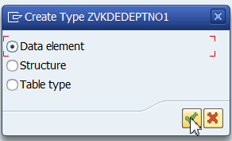
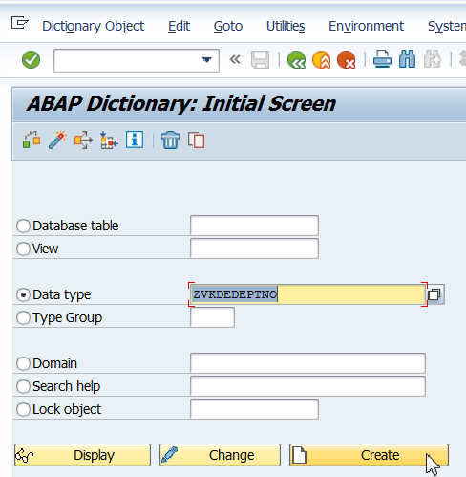
Creating Data Element
Go to Tcode : SE11
Choose Data Type
Specify the Data Element Name
Click on CREATE

Slide 32
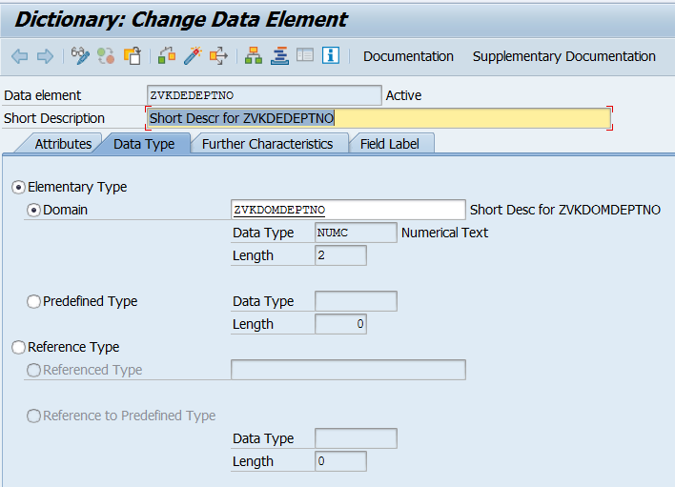
Creating Data Element
Specify the Domain Name

Slide 33
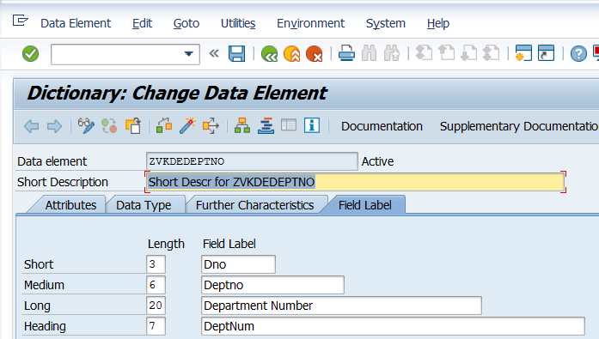
Creating Data Element
Save
Specify the Field Label
Activate

Slide 34
Demo
Create a simple table based data elements and domain

Slide 35
Standard Tables
Few Frequently Used Tables
Table Name | Description
MARA | Material Master
KNA1 | Customer Master
LFA1 | Vendor Master
VBAK | Sales Document : Header Data
VBAP | Sales Document : Item Data
EKKO | Purchase Document : Header
EKPO | Purchase Document : Item

Slide 36
Review Question
Question 1: A _______ in the dictionary has a one to one relationship with a table in the database.
Question 2: The _____ determines the table space that the table is assigned to.
Question 3: An ____ can be used to speed up the selection of data records from a table.

Slide 37
Summary
In this lesson, you have learnt:
To Use Data Dictionary to maintain Database Objects
To Work with
Domain
Data Elements

